Slide 1

Exploring genome-wide organization of chromatin structure by ChIP-seq
Class III, 2/13/2018
Alon Goren
Department of Medicine,
UCSD

Slide 2
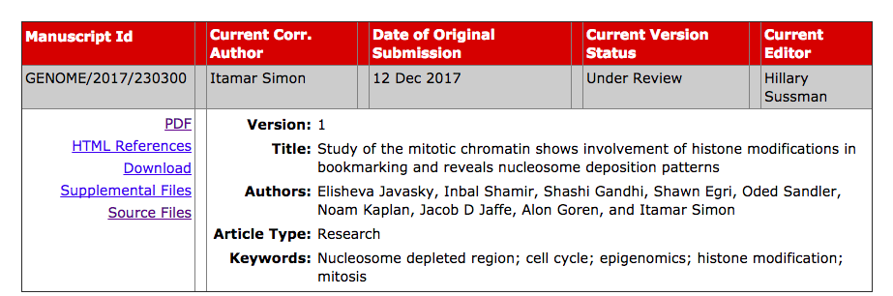
https://broadinstitute.github.io/picard/explain-flags.html

Slide 3
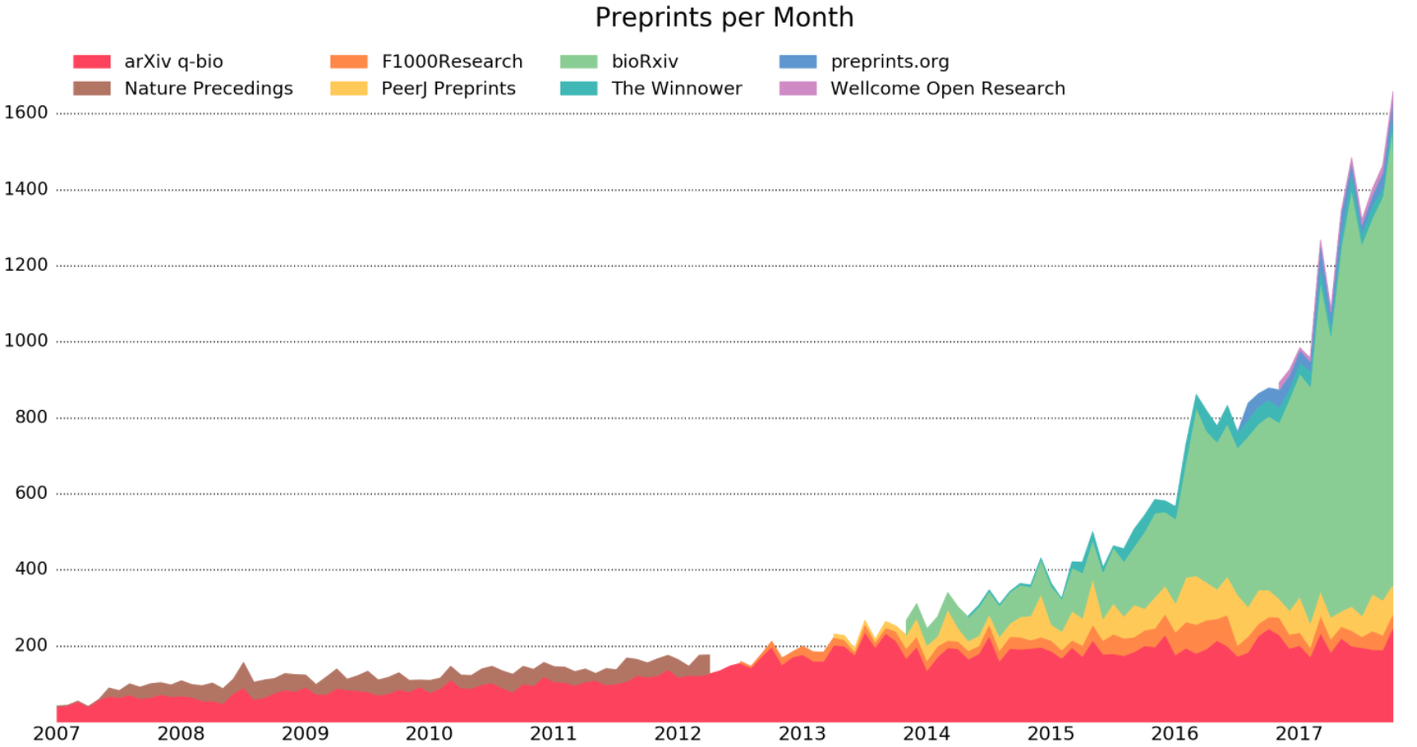
https://www.biorxiv.org/

Slide 4
Study of the mitotic epigenomic landscape
Regulation of nucleosome deposition

Slide 5
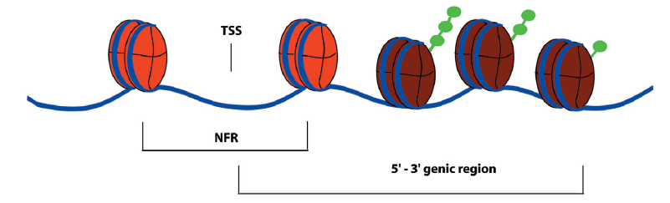
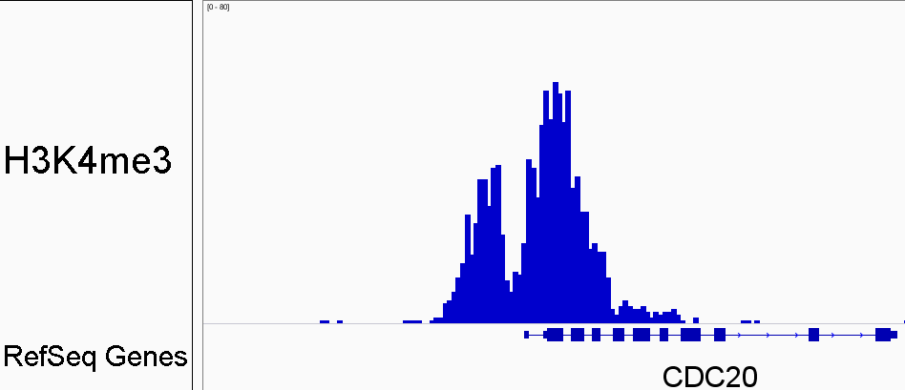
Nucleosome Free Regions (NFRs)
H3K4me3
RefSeq Genes
Lee et al. Nat. Genetics, 2004; Hawkins & Ren Human Molecular Genetics, 2006

Slide 6
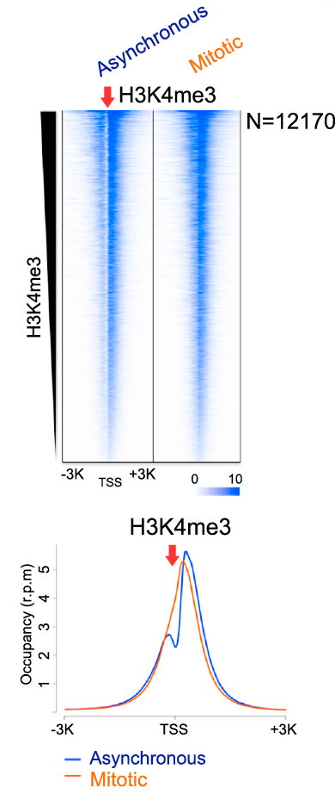
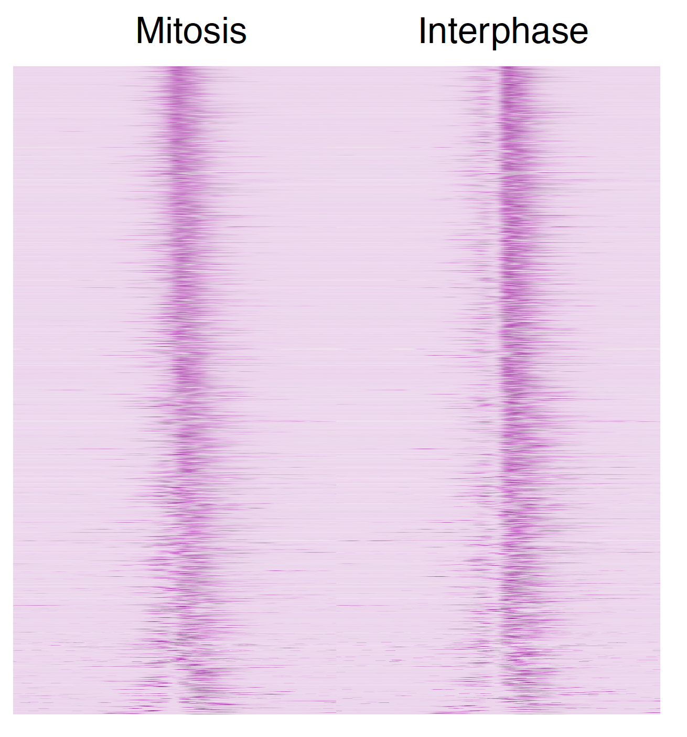
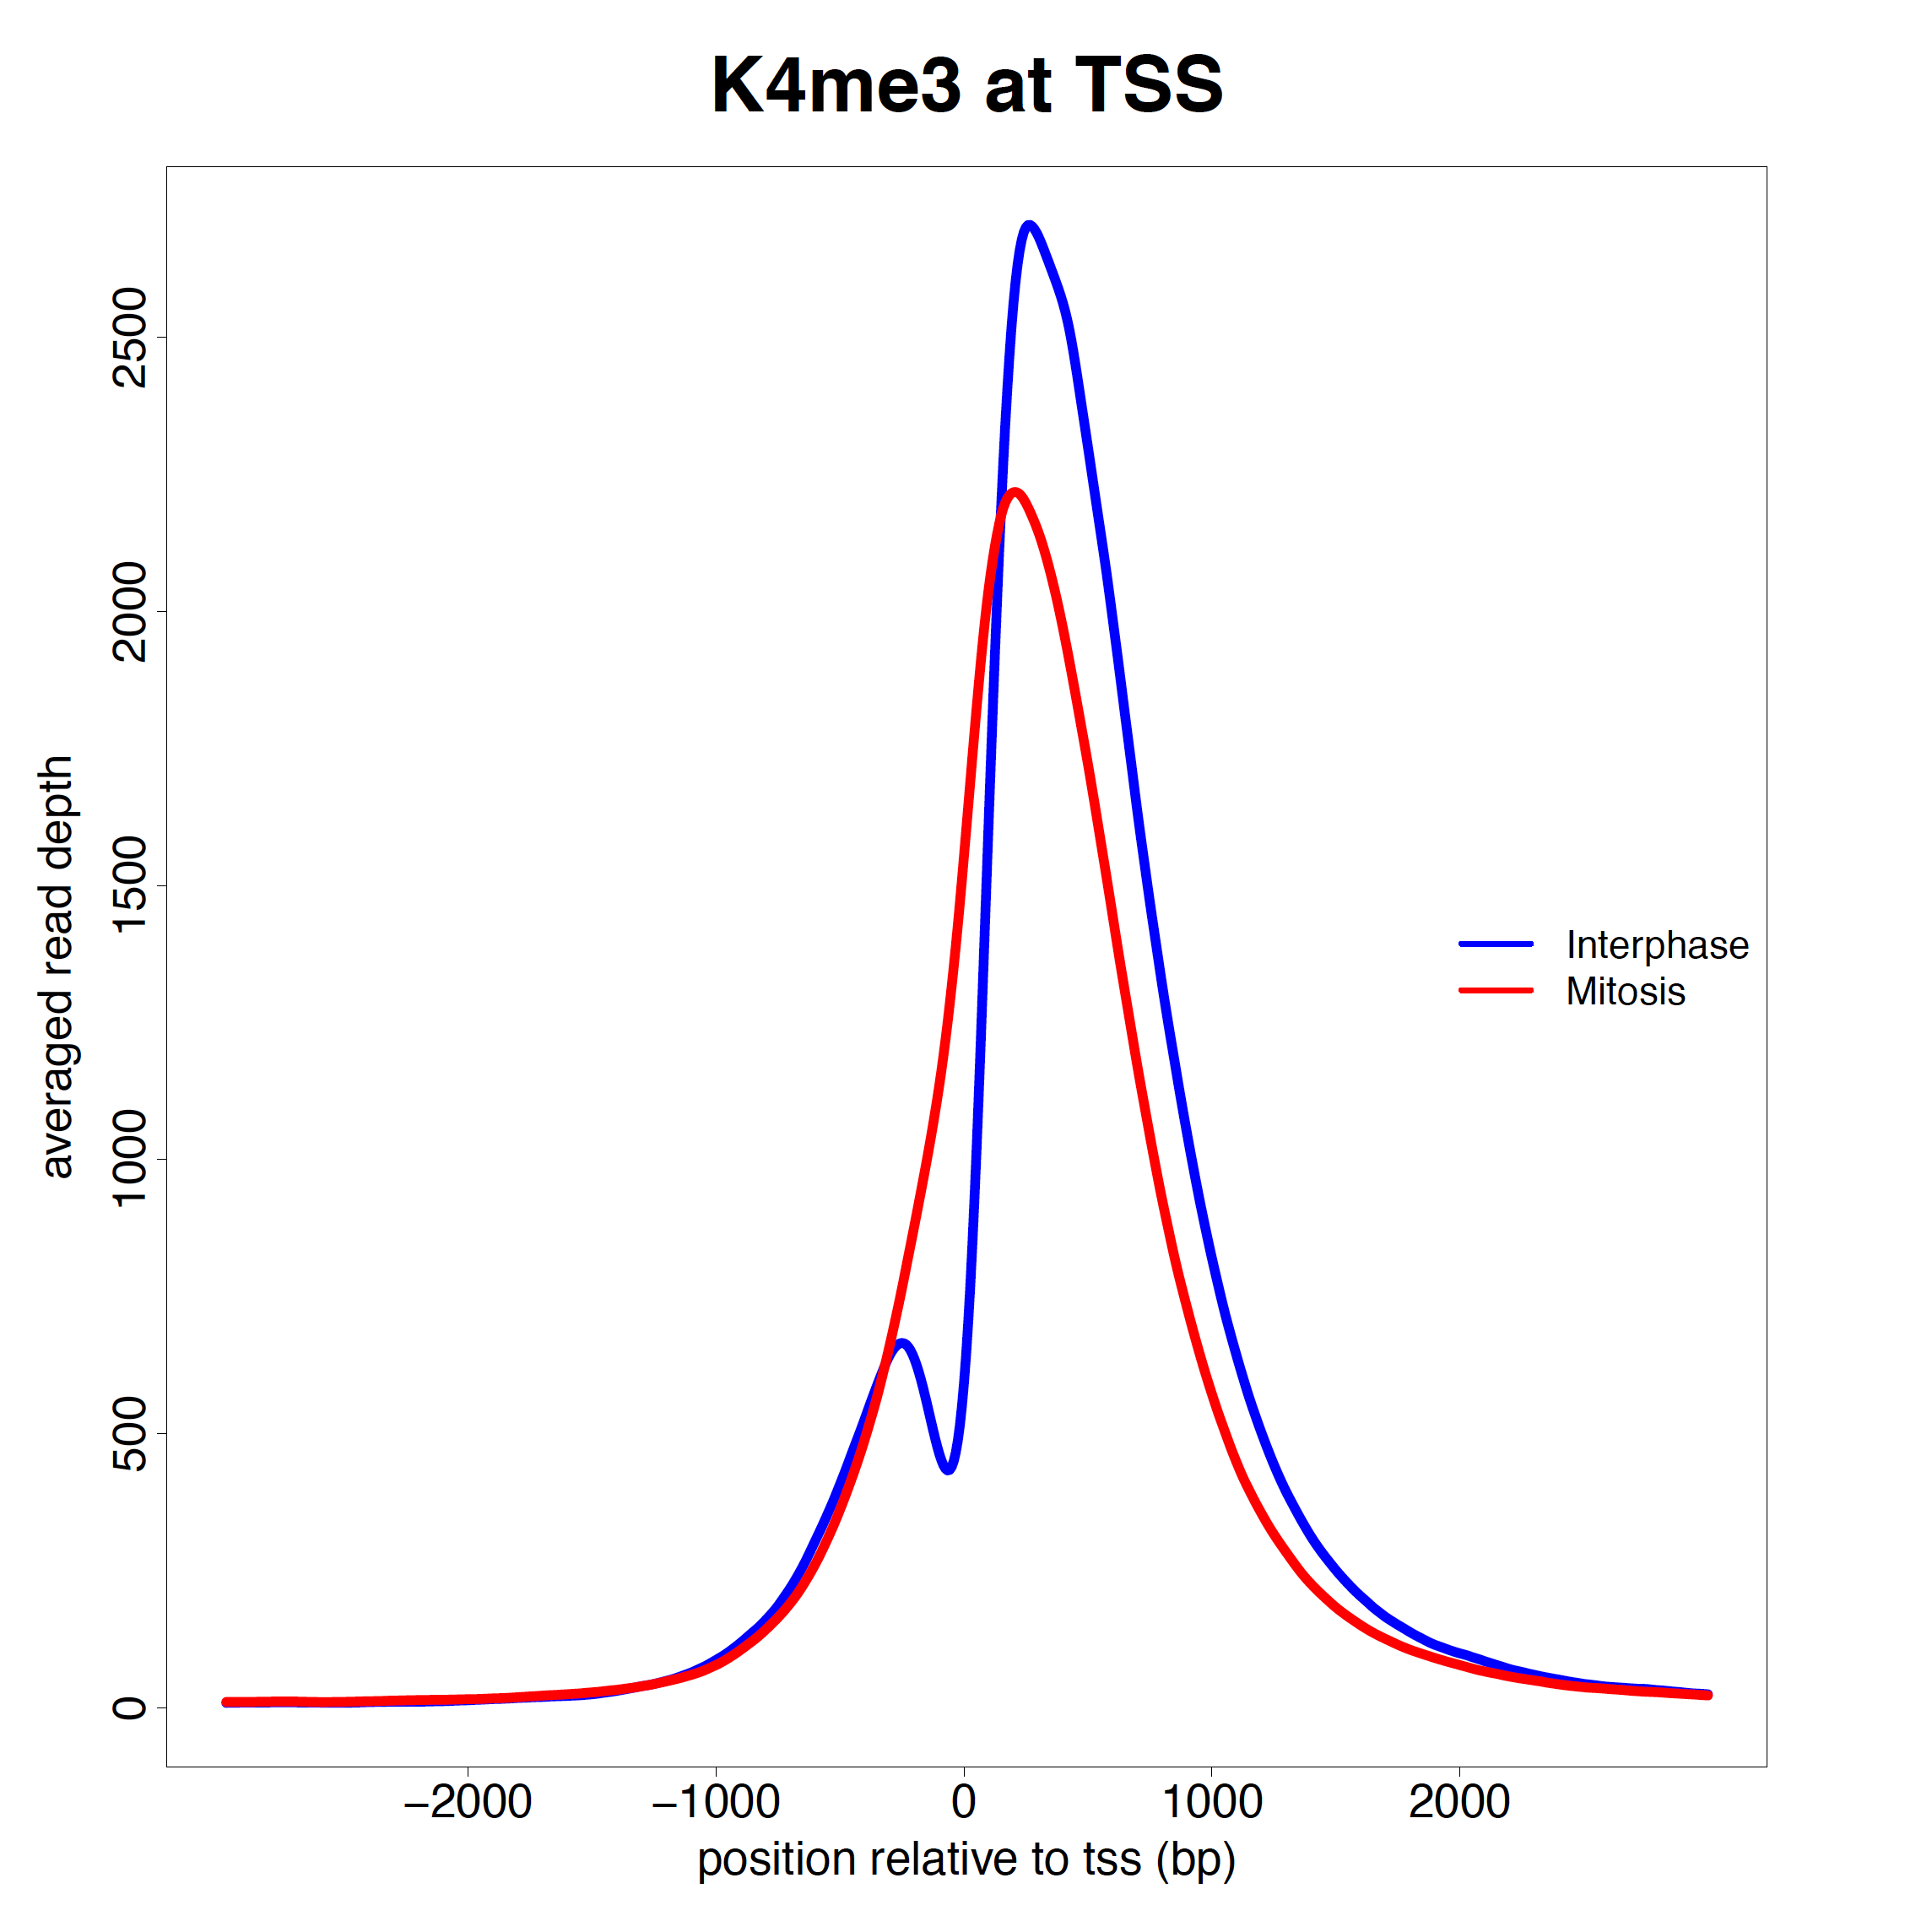
Loss of Nucleosome Free Regions (NFRs) during mitosis
Mitotic
Interphase
H3K4me3
Liang et al. Molecular Cell, 2015

Slide 7
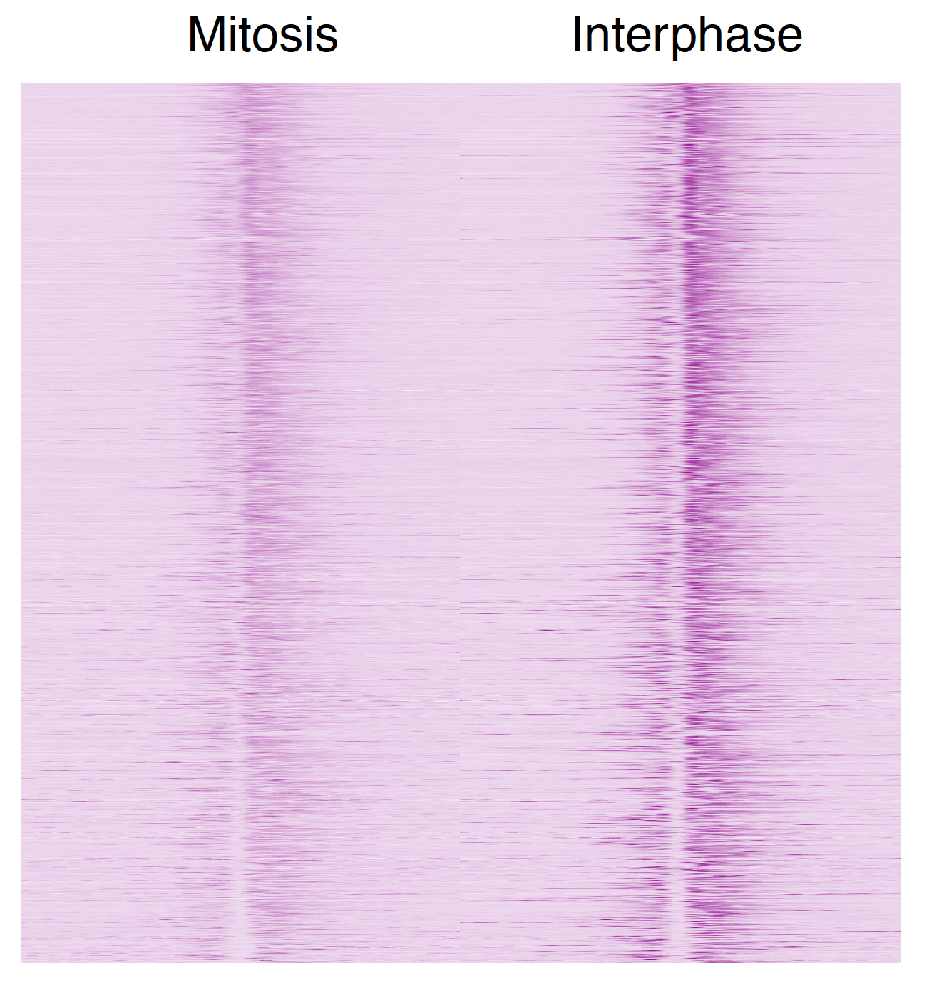
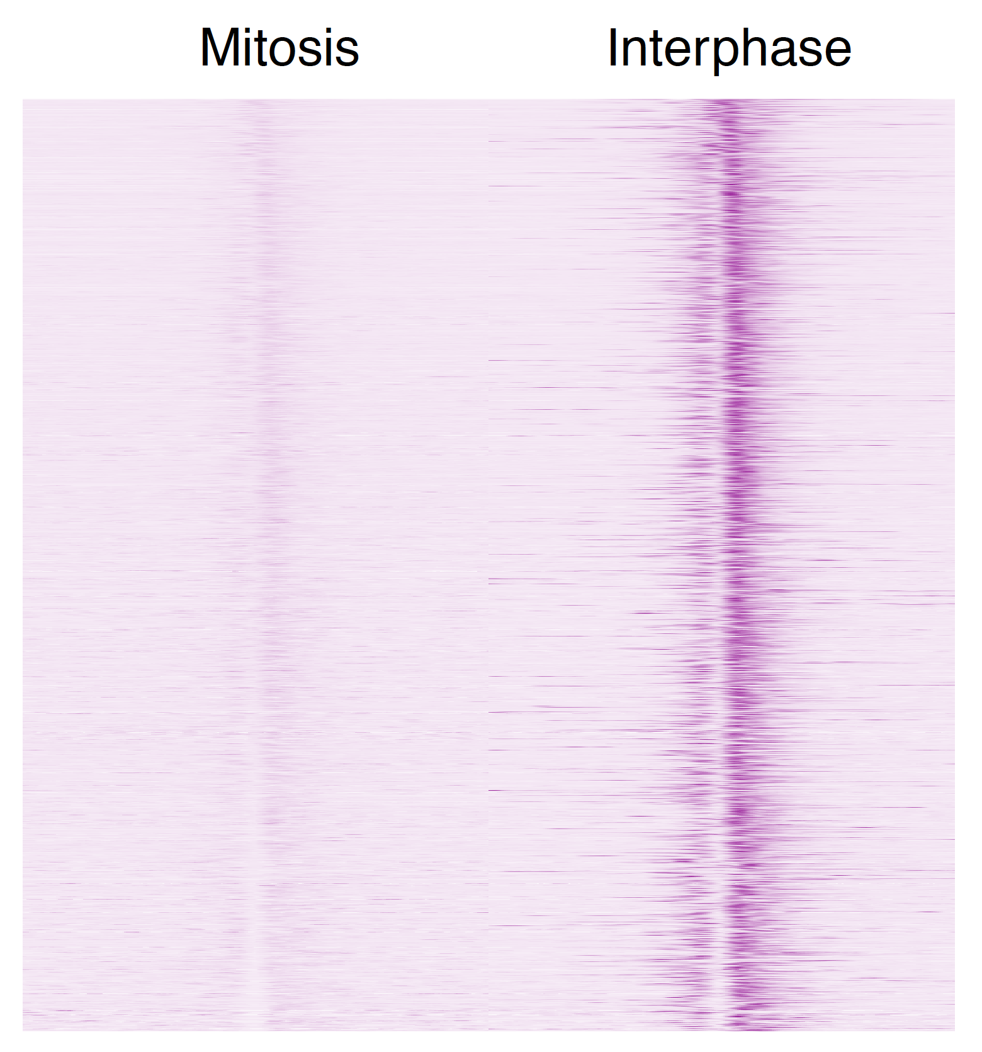
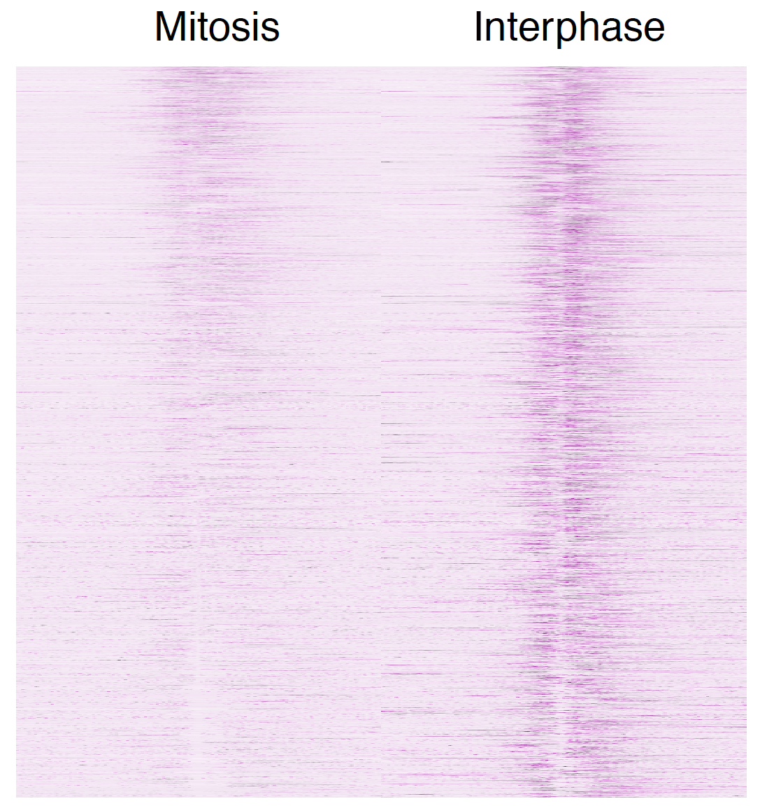
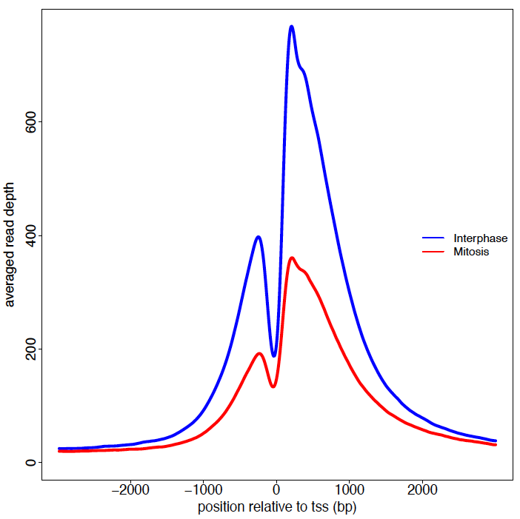
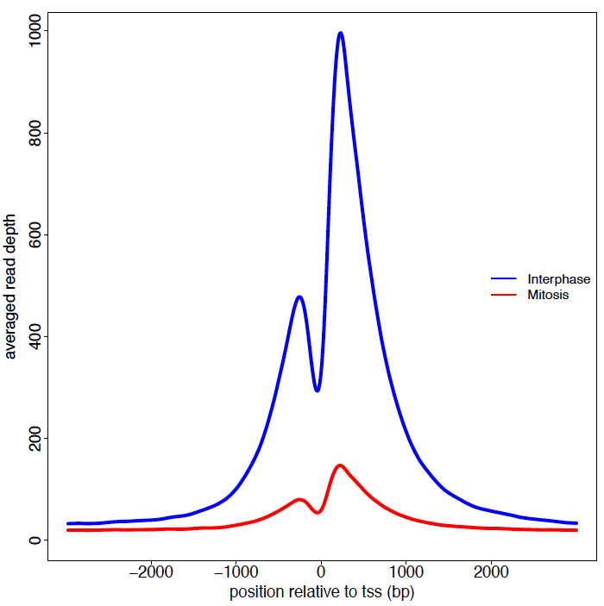
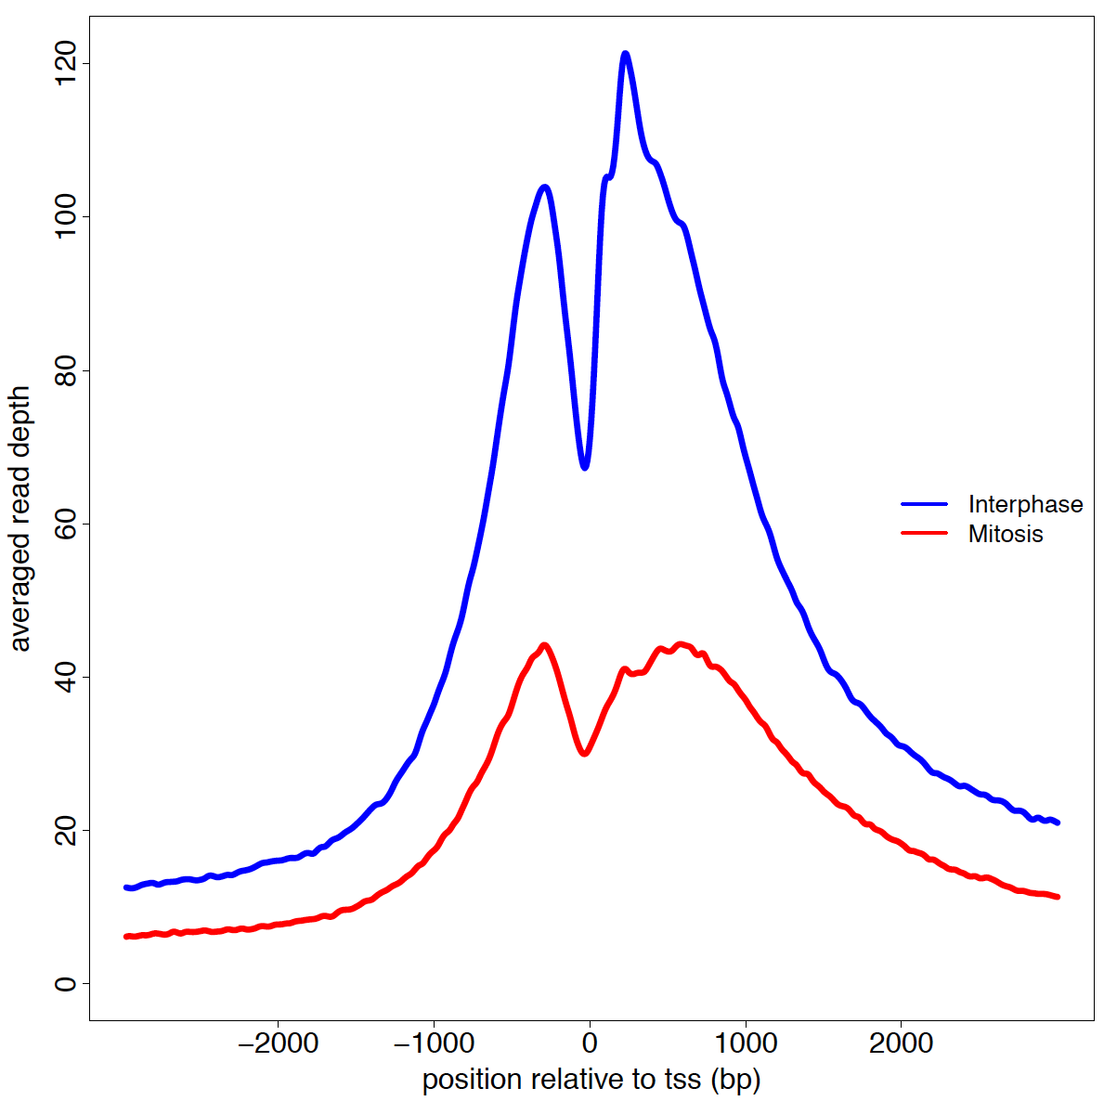
Histone acetylations retain mitotic NFR structure
& conserved in mouse
HeLaS
Mouse G1E cells
H3K9ac
H3K27ac
H3K27ac
Mouse data from: Hsiung et al. Genes & Dev, 2016

Slide 8
The TSS nucleosome is distinguishable from its surrounding
H3K4me3
H3K9ac
H3K27ac

Slide 9
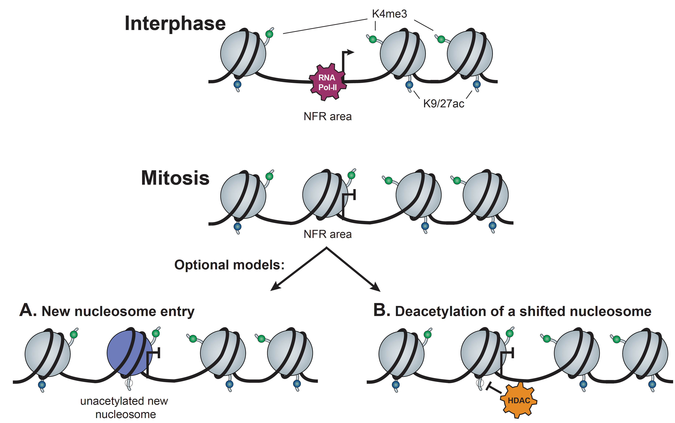
Possible models for explaining NFR loss

Slide 10
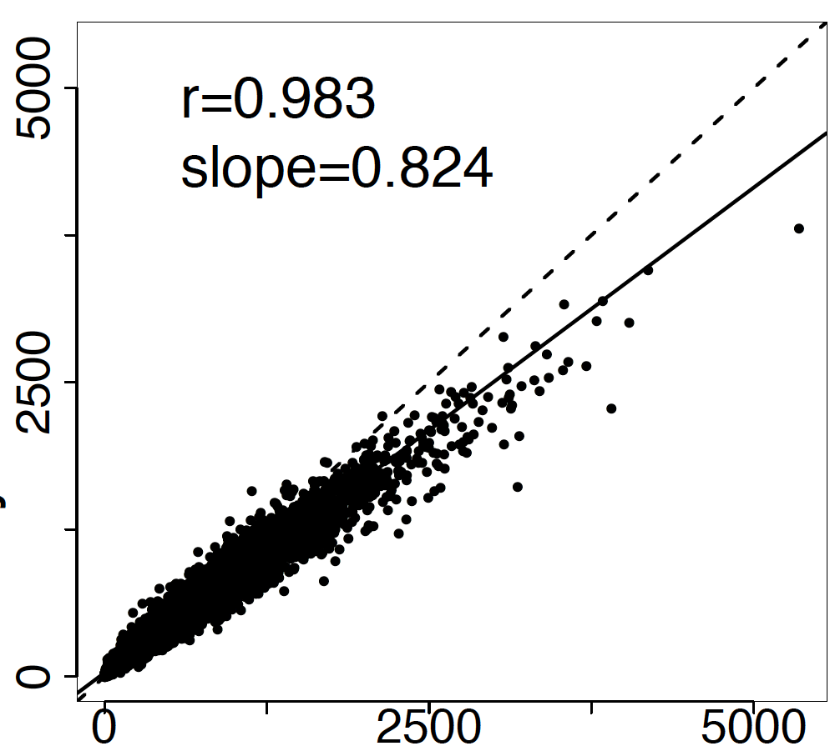
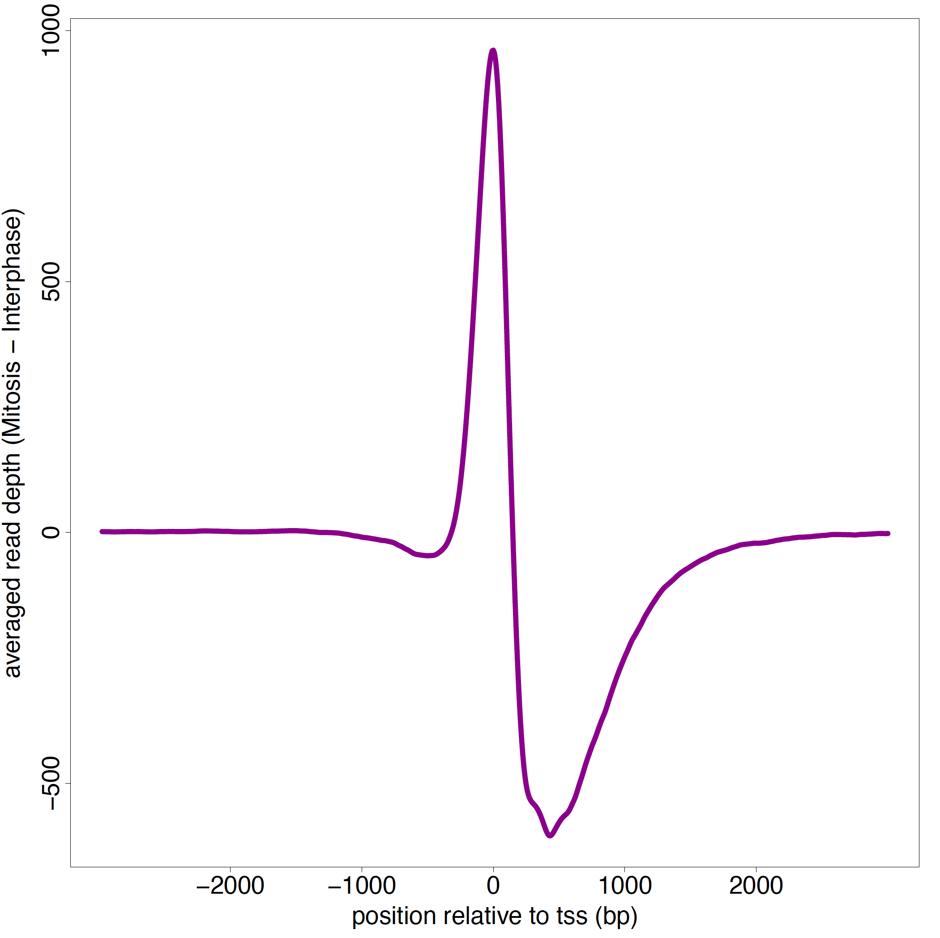
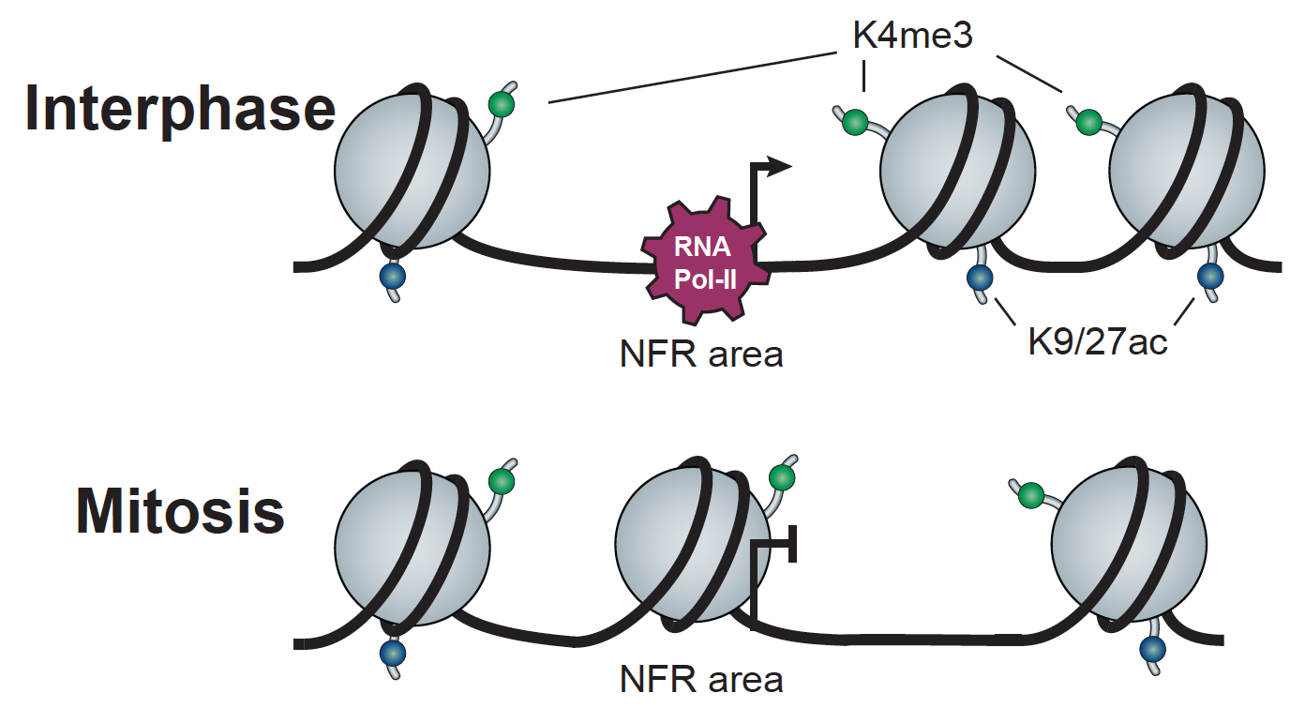
H3K4me3 patterns support for the nucleosome shift model
∆ of Mitosis to Interphase (H3K4me3)
H3K4me3 abundance
(Proteomics)
H3K4me3
Relative Abundance %
Mitosis
Interphase
Mitosis
Interphase

Slide 11
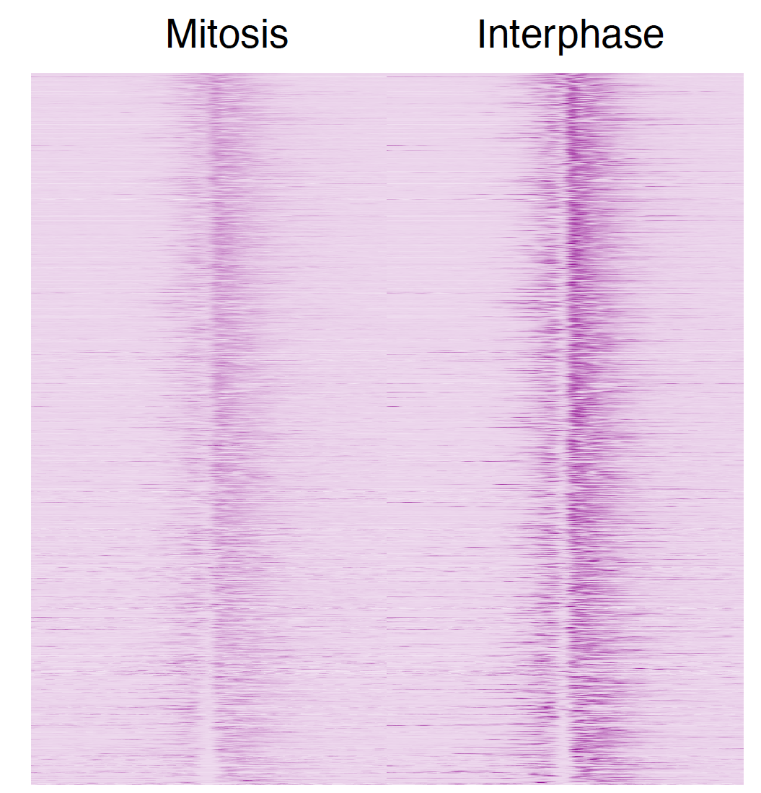
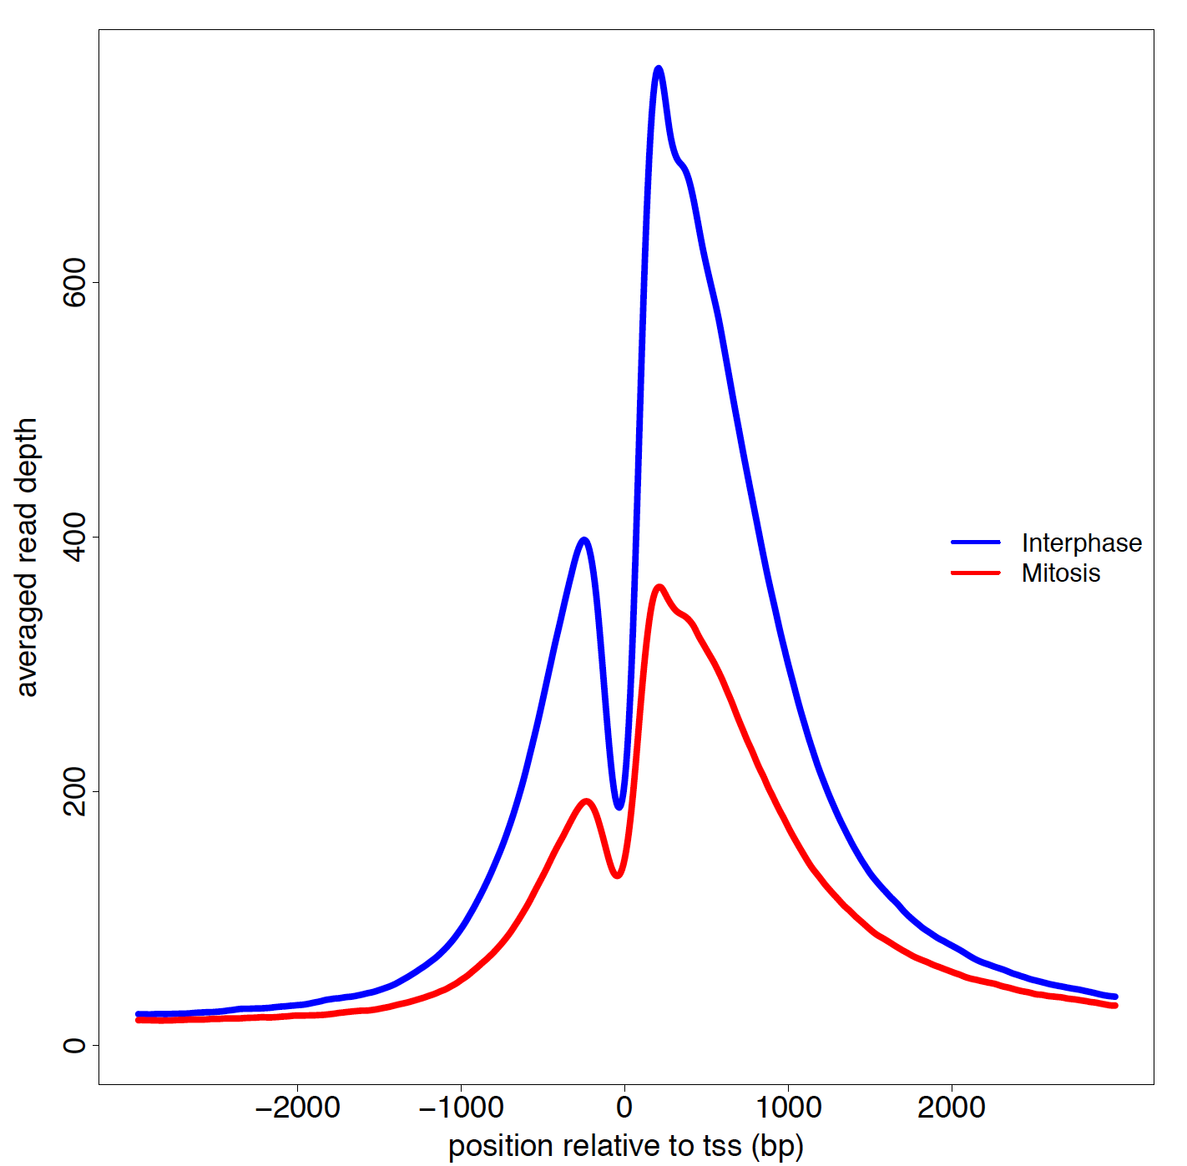
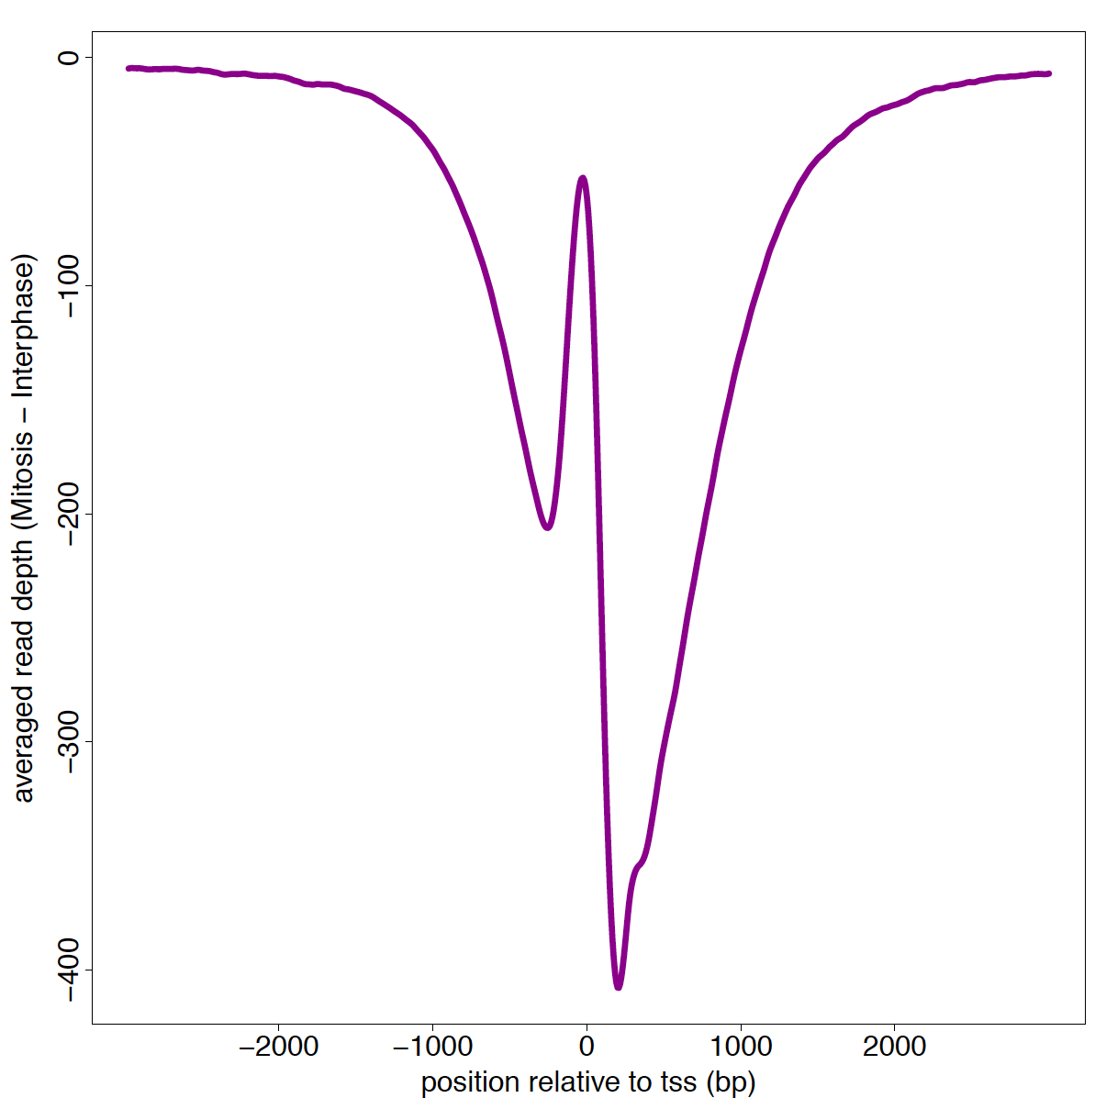
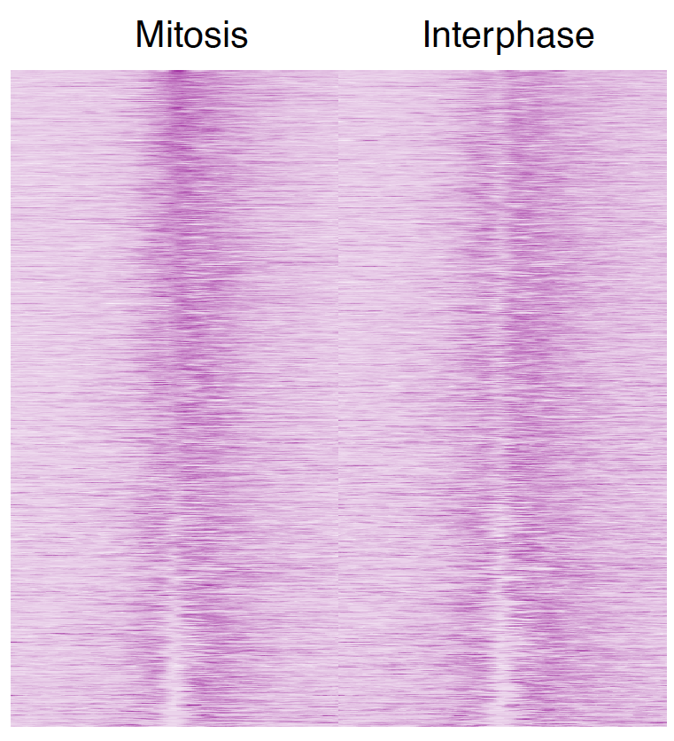
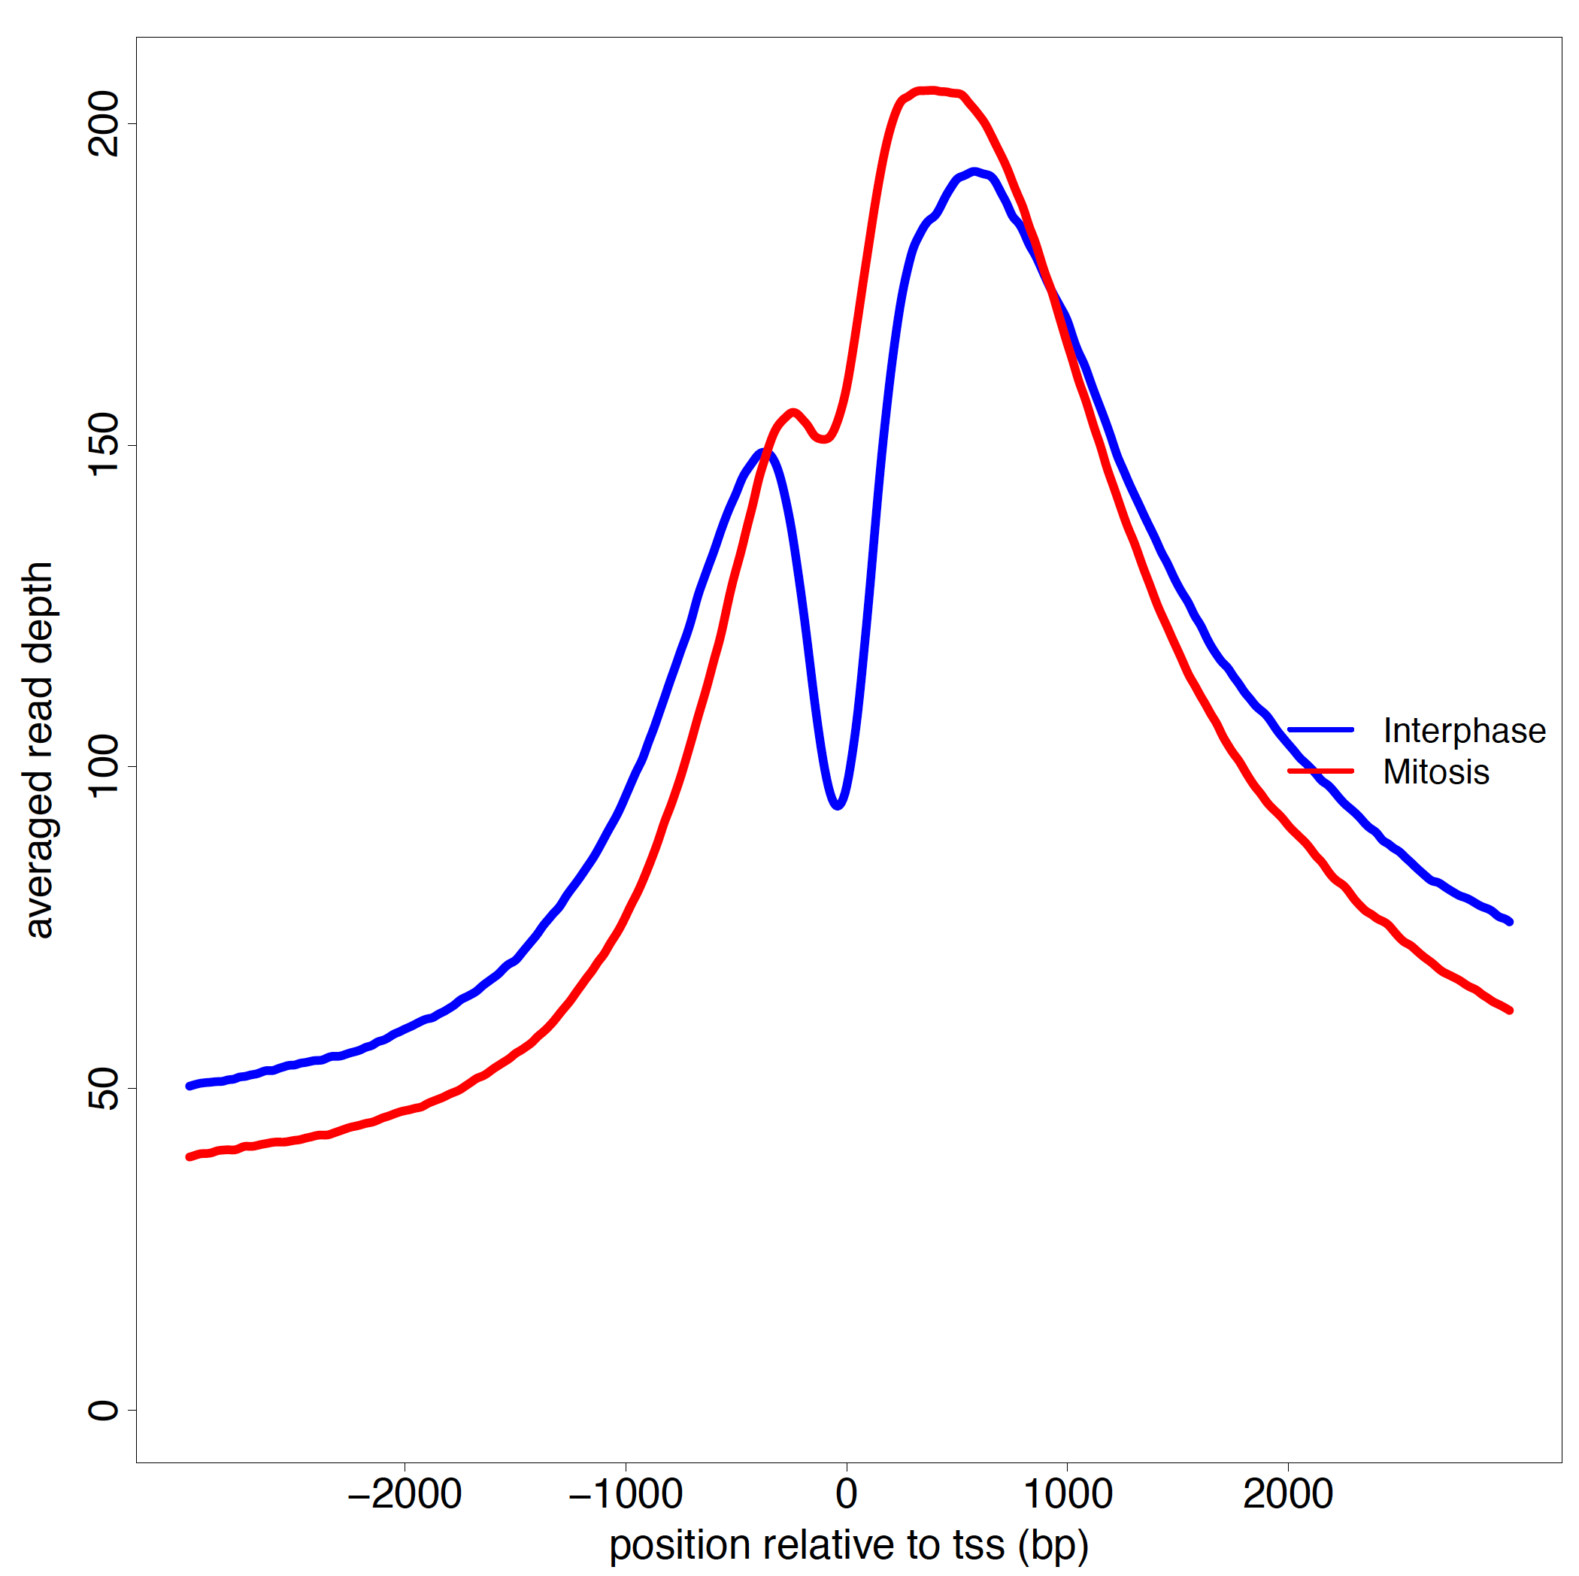
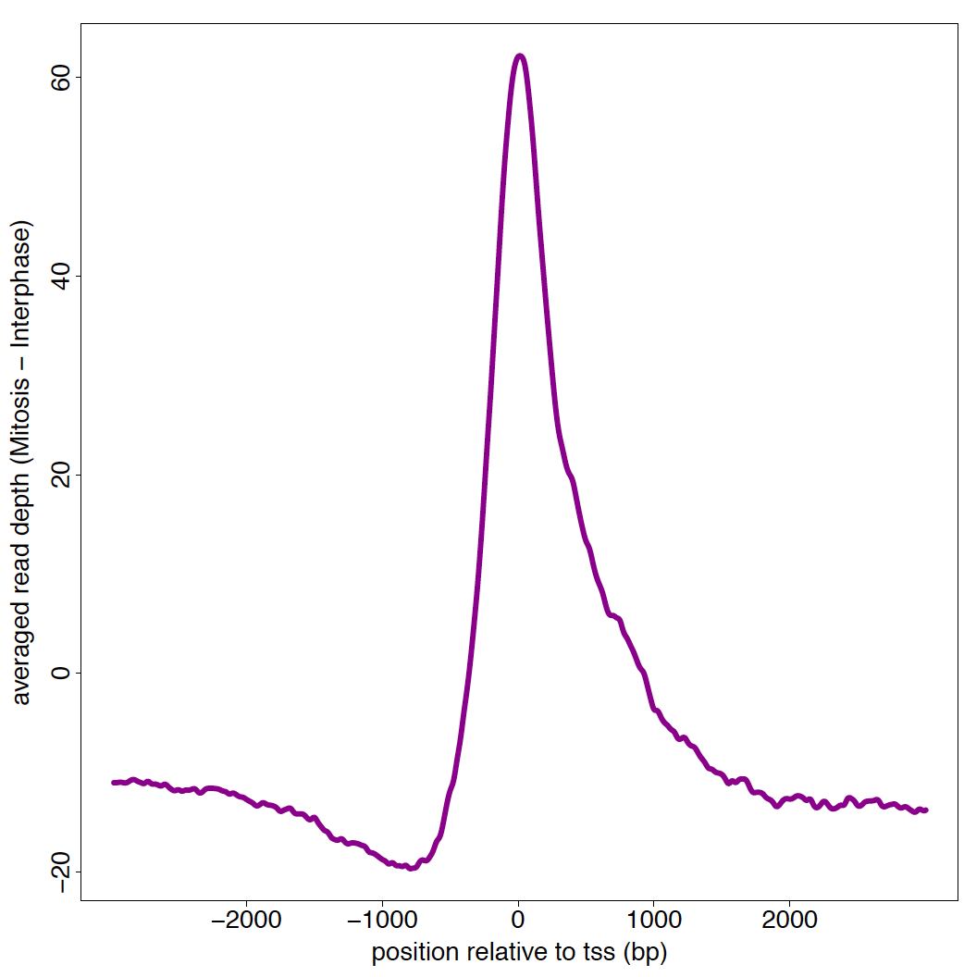
Inhibition of HDACs by TSA removes the acetylation NFR pattern
∆ of Mitosis to Interphase
H3K9ac;
No TSA
Averaged read depth
Averaged read depth (mitosis – Interphase)
Position relative to TSS (bp)
Position relative to TSS (bp)
H3K9ac;
150mM TSA
Position relative to TSS (bp)
Position relative to TSS (bp)
Notes:
Substruction

Slide 12
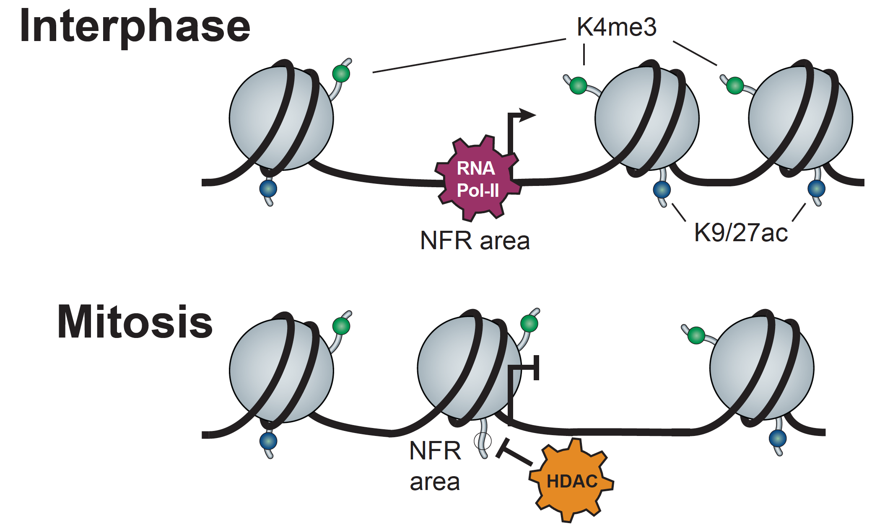
Mitotic nucleosome depositioning
A nucleosome marked with H3K4me3 is present at NFRs during mitosis.
This TSS nucleosome is distinguishable from its surroundings
The +1 nucleosome appears to shift into the NFR area
During mitosis there is specific deaceylation of the shifted nucleosome by HDAC/s

Slide 13
Questions ?

Slide 14
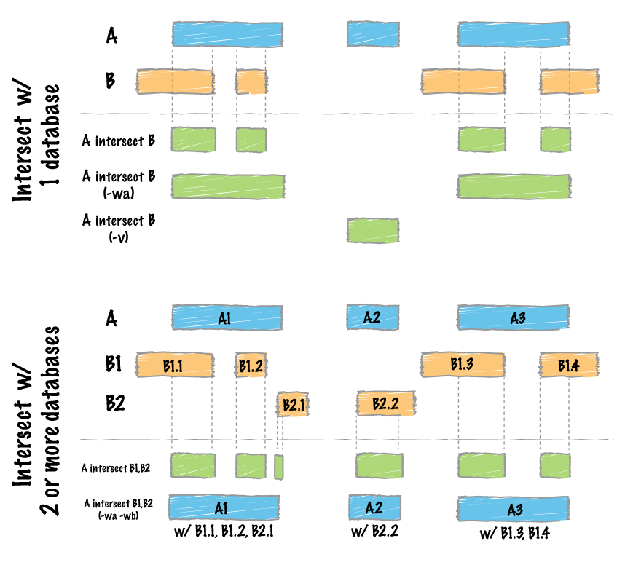
bedtools “intersect”

Slide 15
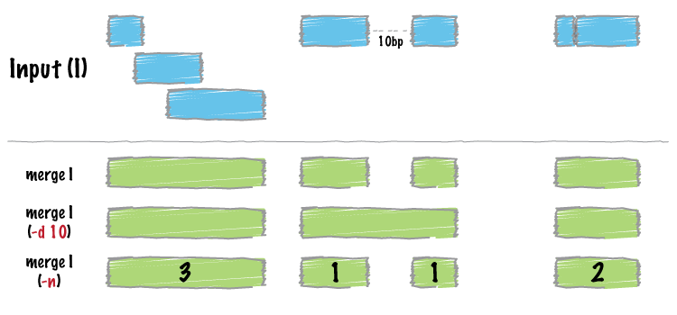
bedtools “merge”

Slide 16
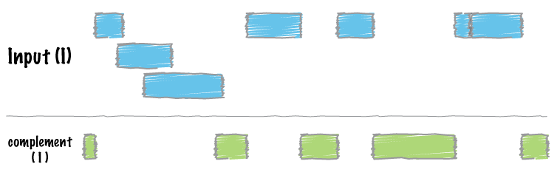
bedtools “complement”

Slide 17
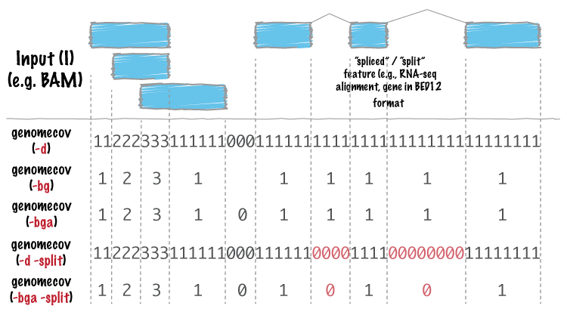
bedtools “genomecov”

Slide 18
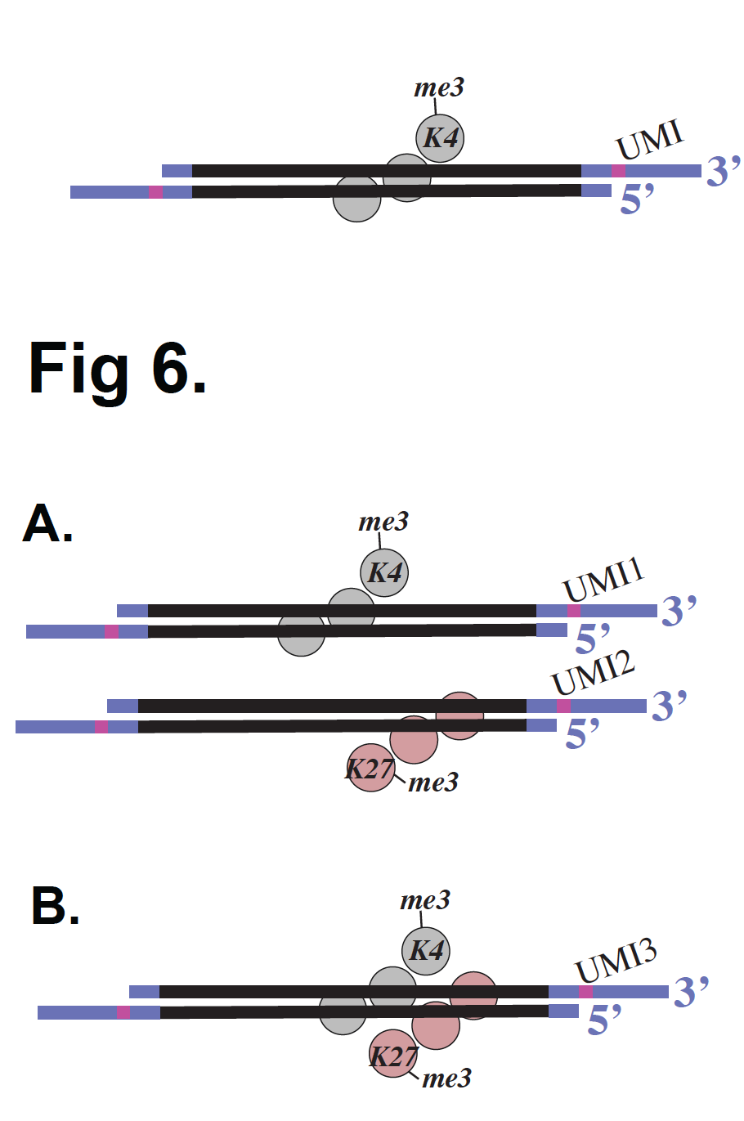
Internal Standards

Slide 19
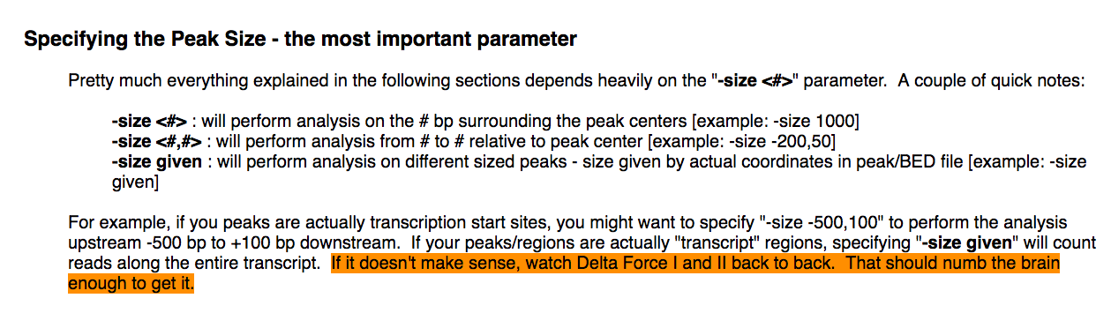
http://homer.ucsd.edu/homer/ngs/quantification.html

Slide 20
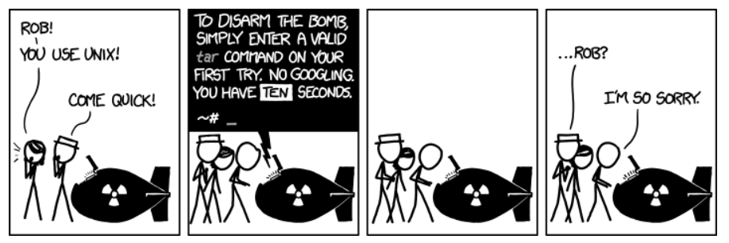
tar
https://xkcd.com/1168/

